Slide 1
CS 61C: Great Ideas in Computer Architecture Lecture 13: Pipelining
Krste Asanović & Randy Katz
http://inst.eecs.berkeley.edu/~cs61c/fa17

Slide 2
Agenda
RISC-V Pipeline
Pipeline Control
Hazards
Structural
Data
R-type instructions
Load
Control
Superscalar processors

Slide 3

Recap: Pipelining with RISC-V
t_{instruction}
add t0, t1, t2
instruction sequence
or t3, t4, t5
sll t6, t0, t3
t_{cycle}
 | Single Cycle | Pipelining
Timing | t_{step} = 100 … 200 ps | t_{cycle} = 200 ps
 | Register access only 100 ps | All cycles same length
Instruction time, t_{instruction} | = t_{cycle} = 800 ps | 1000 ps
Clock rate, f_{s} | 1/800 ps = 1.25 GHz | 1/200 ps = 5 GHz
Relative speed | 1 x | 4 x
Notes:
Tc = “Time between completion of instructions”

Slide 4
RISC-V Pipeline
t_{instruction} = 1000 ps
Resource use in a particular time slot
add t0, t1, t2
Resource use of instruction over time
or t3, t4, t5
slt t6, t0, t3
instruction sequence
sw t0, 4(t3)
lw t0, 8(t3)
t_{cycle}
= 200 ps
addi t2, t2, 1

Slide 5
Single-Cycle RISC-V RV32I Datapath
+4
Reg[]
pc
pc+4
pc
wb
1
alu
1
DataD
Reg[rs1]
ALU
2
alu
0
DMEM
0
IMEM
inst[11:7]
AddrD
Addr
1
pc+4
Branch Comp.
Reg[rs2]
DataR
wb
inst[19:15]
AddrA
DataA
0
0
DataW
mem
inst[24:20]
AddrB
DataB
1
inst[31:7]
Imm.
Gen
imm[31:0]
PCSel
inst[31:0]
ImmSel
RegWEn
BrUn
BrEq
BrLT
BSel
ASel
ALUSel
MemRW
WBSel

Slide 6
Pipelining RISC-V RV32I Datapath
+4
Reg[]
pc
pc+4
pc
wb
1
alu
1
DataD
Reg[rs1]
ALU
2
alu
0
DMEM
0
IMEM
inst[11:7]
AddrD
Addr
1
pc+4
Branch Comp.
Reg[rs2]
DataR
wb
inst[19:15]
AddrA
DataA
0
0
DataW
mem
inst[24:20]
AddrB
DataB
1
inst[31:7]
Imm.
Gen
imm[31:0]
Instruction Fetch
(F)
Instruction Decode/Register Read
(D)
ALU Execute
(X)
Memory Access
(M)
Write Back
(W)

Slide 7
Pipelined RISC-V RV32I Datapath
Recalculate PC+4 in M stage to avoid sending both PC and PC+4 down pipeline
pc_{X}
pc_{M}
pc_{F}
pc_{D}
+4
+4
Reg[]
rs1_{X}
1
DataD
ALU
alu_{X}
DMEM
0
AddrD
alu_{M}
Addr
pc_{F}+4
IMEM
Branch Comp.
DataR
AddrA
DataA
DataW
DataB
AddrB
inst_{D}
rs2_{X}
rs2_{M}
imm_{X}
Imm.
inst_{X}
inst_{M}
inst_{W}
Must pipeline instruction along with data, so control operates correctly in each stage

Slide 8
Each stage operates on different instruction
lw t0, 8(t3)
sw t0, 4(t3)
slt t6, t0, t3
or t3, t4, t5
add t0, t1, t2
pc_{X}
pc_{M}
pc_{F}
pc_{D}
+4
+4
Reg[]
rs1_{X}
1
DataD
ALU
alu_{X}
DMEM
0
AddrD
alu_{M}
Addr
pc_{F}+4
IMEM
Branch Comp.
DataR
AddrA
DataA
DataW
DataB
AddrB
inst_{D}
rs2_{X}
rs2_{M}
imm_{X}
Imm.
inst_{X}
inst_{M}
inst_{W}
Pipeline registers separate stages, hold data for each instruction in flight

Slide 9
Agenda
RISC-V Pipeline
Pipeline Control
Hazards
Structural
Data
R-type instructions
Load
Control
Superscalar processors

Slide 10
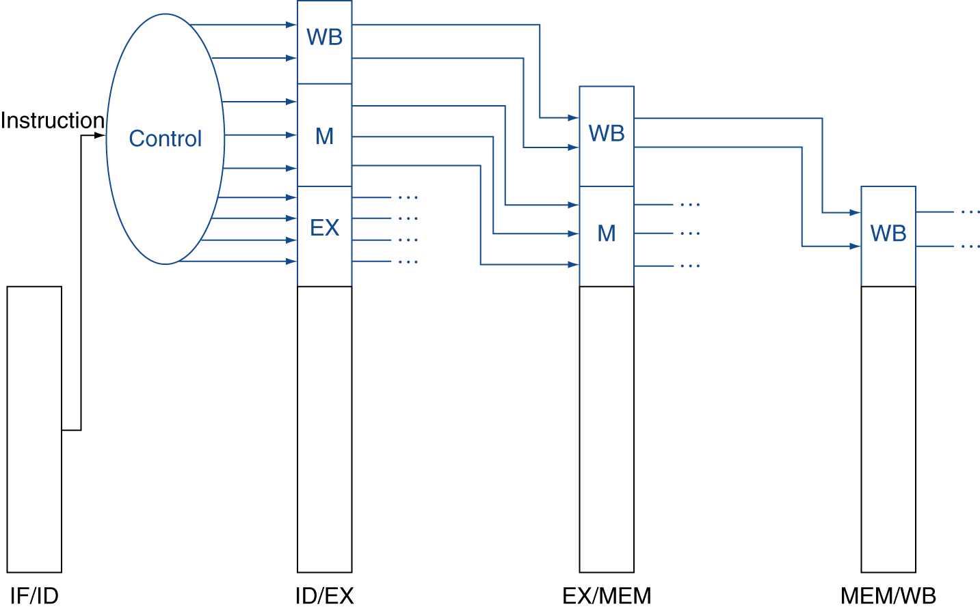
Pipelined Control
Control signals derived from instruction
As in single-cycle implementation
Information is stored in pipeline registers for use by later stages

Slide 11
Hazards Ahead

Slide 12
Agenda
RISC-V Pipeline
Pipeline Control
Hazards
Structural
Data
R-type instructions
Load
Control
Superscalar processors

Slide 13
Structural Hazard
Problem: Two or more instructions in the pipeline compete for access to a single physical resource
Solution 1: Instructions take it in turns to use resource, some instructions have to stall
Solution 2: Add more hardware to machine
Can always solve a structural hazard by adding more hardware

Slide 14
Regfile Structural Hazards
Each instruction:
can read up to two operands in decode stage
can write one value in writeback stage
Avoid structural hazard by having separate “ports”
two independent read ports and one independent write port
Three accesses per cycle can happen simultaneously

Slide 15
Structural Hazard: Memory Access
Instruction and data memory used simultaneously
Use two separate memories
add t0, t1, t2
or t3, t4, t5
slt t6, t0, t3
instruction sequence
sw t0, 4(t3)
lw t0, 8(t3)

Slide 16
Instruction and Data Caches
Processor
Memory (DRAM)
Control
Instruction Cache
Program
Datapath
PC
Bytes
Data
Cache
Registers
Arithmetic & Logic Unit
(ALU)
Data
Caches: small and fast “buffer” memories

Slide 17
Structural Hazards – Summary
Conflict for use of a resource
In RISC-V pipeline with a single memory
Load/store requires data access
Without separate memories, instruction fetch would have to stall for that cycle
All other operations in pipeline would have to wait
Pipelined datapaths require separate instruction/data memories
Or separate instruction/data caches
RISC ISAs (including RISC-V) designed to avoid structural hazards
e.g. at most one memory access/instruction

Slide 18
Agenda
RISC-V Pipeline
Pipeline Control
Hazards
Structural
Data
R-type instructions
Load
Control
Superscalar processors

Slide 19
Data Hazard: Register Access
Separate ports, but what if write to same value as read?
Does sw in the example fetch the old or new value?
add t0, t1, t2
or t3, t4, t5
slt t6, t0, t3
instruction sequence
sw t0, 4(t3)
lw t0, 8(t3)

Slide 20
Register Access Policy
Exploit high speed of register file (100 ps)
WB updates value
ID reads new value
Indicated in diagram by shading
add t0, t1, t2
or t3, t4, t5
instruction sequence
slt t6, t0, t3
sw t0, 4(t3)
lw t0, 8(t3)
Might not always be possible to write then read in same cycle, especially in high-frequency designs. Check assumptions in any question.

Slide 21
Data Hazard: ALU Result
Value of s0
5 | 5 | 5 | 5 | 5/9 | 9 | 9 | 9 | 9
add s0, t0, t1
sub t2, s0, t0
or t6, s0, t3
instruction sequence
xor t5, t1, s0
sw s0, 8(t3)
Without some fix, sub and or will calculate wrong result!

Slide 22
Data Hazard: ALU Result
Value of s0
5
add s0, t1, t2
sub t2, s0, t5
or t6, s0, t3
instruction sequence
xor t5, t1, s0
sw s0, 8(t3)
Without some fix, sub and or will calculate wrong result!

Slide 23
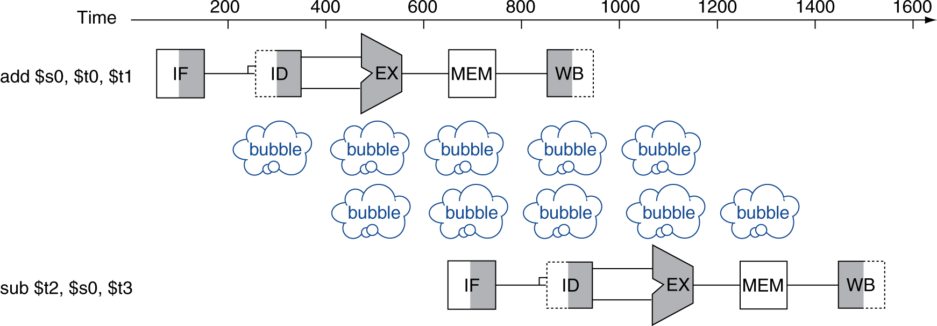
Solution 1: Stalling
Problem: Instruction depends on result from previous instruction
add s0, t0, t1 sub t2, s0, t3
Bubble:
effectively NOP: affected pipeline stages do “nothing”

Slide 24
Stalls and Performance
Stalls reduce performance
But stalls are required to get correct results
Compiler can arrange code to avoid hazards and stalls
Requires knowledge of the pipeline structure

Slide 25
Solution 2: Forwarding
Value of t0
5 | 5 | 5 | 5 | 5/9 | 9 | 9 | 9 | 9
add t0, t1, t2
or t3, t0, t5
sub t6, t0, t3
instruction sequence
xor t5, t1, t0
sw t0, 8(t3)
Forwarding: grab operand from pipeline stage,
rather than register file

Slide 26
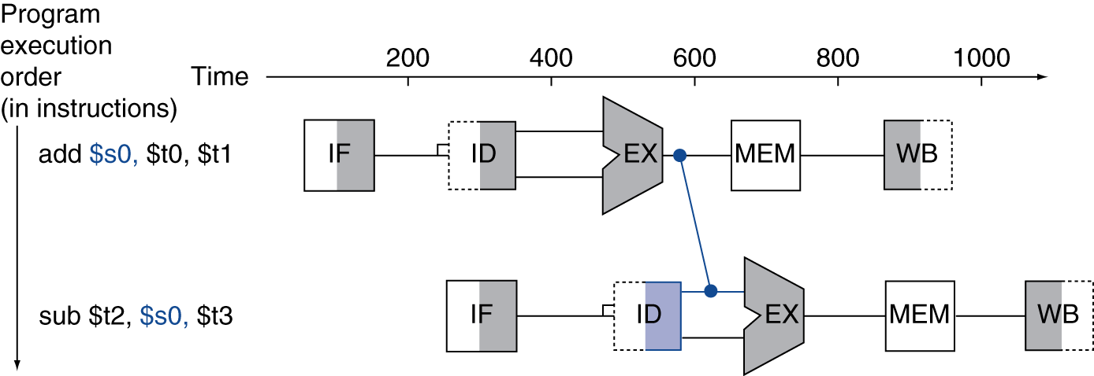
Forwarding (aka Bypassing)
Use result when it is computed
Don’t wait for it to be stored in a register
Requires extra connections in the datapath

Slide 27
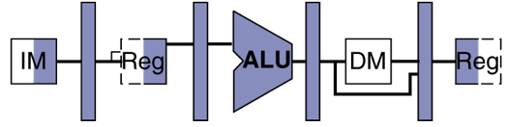
1) Detect Need for Forwarding (example)
Compare destination of older instructions in pipeline with sources of new instruction in decode stage.
Must ignore writes to x0!
D
X
M
W
inst_{X}.rd
add t0, t1, t2
inst_{D}.rs1
or t3, t0, t5
sub t6, t0, t3

Slide 28
Forwarding Path
pc_{X}
pc_{M}
pc_{F}
pc_{D}
+4
+4
Reg[]
rs1_{X}
1
DataD
ALU
alu_{X}
DMEM
0
AddrD
alu_{M}
Addr
pc_{F}+4
IMEM
Branch Comp.
DataR
AddrA
DataA
DataW
DataB
AddrB
inst_{D}
rs2_{X}
rs2_{M}
imm_{X}
Imm.
inst_{X}
inst_{M}
inst_{W}
Forwarding Control Logic

Slide 29
Agenda
RISC-V Pipeline
Pipeline Control
Hazards
Structural
Data
R-type instructions
Load
Control
Superscalar processors

Slide 30
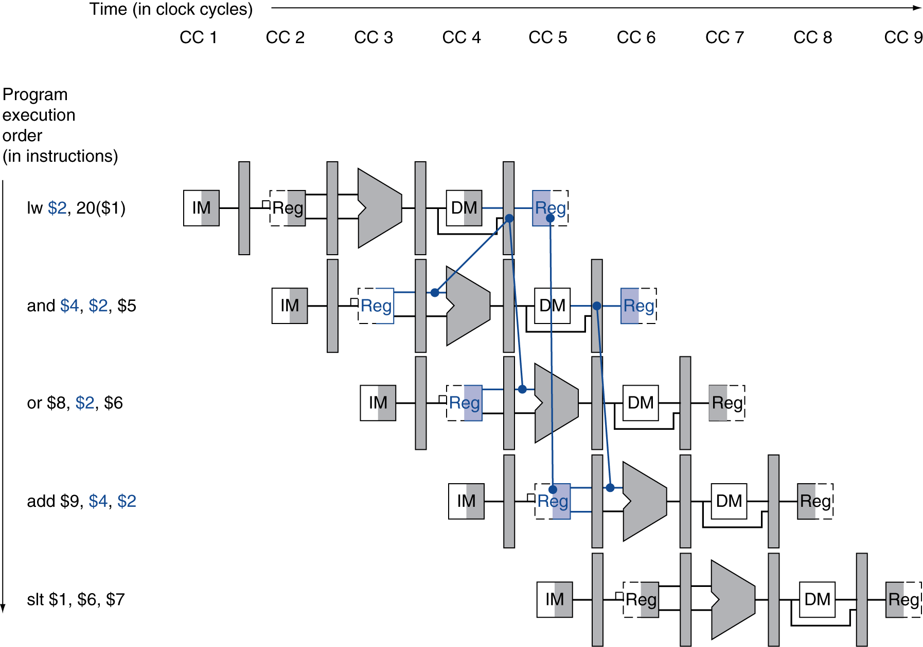
Load Data Hazard
1 cycle stall unavoidable
forward
unaffected

Slide 31
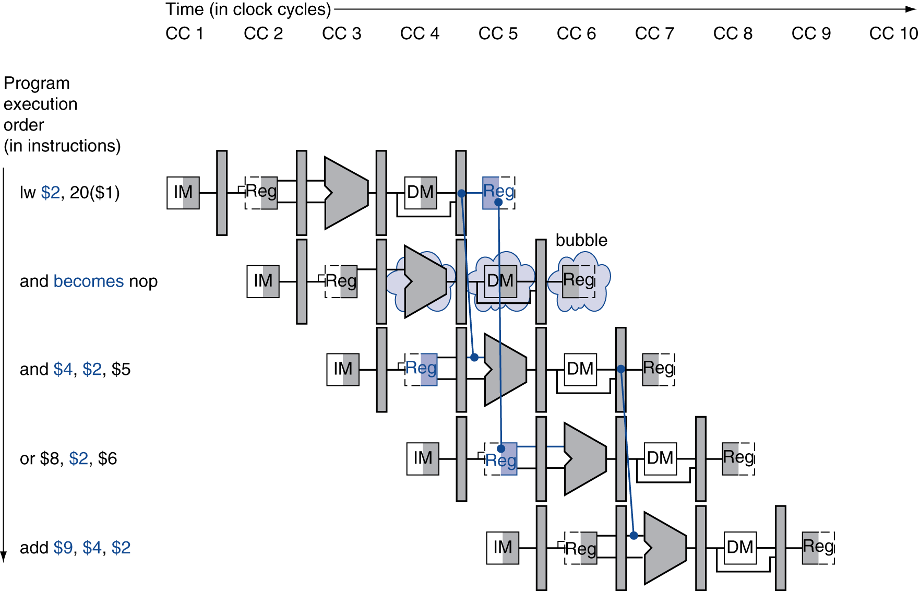
Stall Pipeline
Stall
repeat and instruction and forward

Slide 32
lw Data Hazard
Slot after a load is called a load delay slot
If that instruction uses the result of the load, then the hardware will stall for one cycle
Equivalent to inserting an explicit nop in the slot
except the latter uses more code space
Performance loss
Idea:
Put unrelated instruction into load delay slot
No performance loss!

Slide 33
Code Scheduling to Avoid Stalls
Reorder code to avoid use of load result in the next instruction!
RISC-V code for D=A+B; E=A+C;
Original Order:
lw t1, 0(t0)
lw t2, 4(t0)
add t3, t1, t2
sw t3, 12(t0)
lw t4, 8(t0)
add t5, t1, t4
sw t5, 16(t0)
Alternative:
lw t1, 0(t0)
lw t2, 4(t0)
lw t4, 8(t0)
add t3, t1, t2
sw t3, 12(t0)
add t5, t1, t4
sw t5, 16(t0)
Stall!
Stall!
11 cycles
13 cycles

Slide 34
Agenda
RISC-V Pipeline
Pipeline Control
Hazards
Structural
Data
R-type instructions
Load
Control
Superscalar processors

Slide 35
Control Hazards
beq t0, t1, label
sub t2, s0, t5
executed regardless of branch outcome!
executed regardless of branch outcome!!!
or t6, s0, t3
PC updated reflecting branch outcome
xor t5, t1, s0
sw s0, 8(t3)

Slide 36
Observation
If branch not taken, then instructions fetched sequentially after branch are correct
If branch or jump taken, then need to flush incorrect instructions from pipeline by converting to NOPs

Slide 37
Kill Instructions after Branch if Taken
Taken branch
beq t0, t1, label
Convert to NOP
sub t2, s0, t5
Convert to NOP
or t6, s0, t3
PC updated reflecting branch outcome
label: xxxxxx

Slide 38
Reducing Branch Penalties
Every taken branch in simple pipeline costs 2 dead cycles
To improve performance, use “branch prediction” to guess which way branch will go earlier in pipeline
Only flush pipeline if branch prediction was incorrect

Slide 39
Branch Prediction
Taken branch
beq t0, t1, label
Guess next PC!
label: …..
…..
Check guess correct

Slide 40
Agenda
RISC-V Pipeline
Pipeline Control
Hazards
Structural
Data
R-type instructions
Load
Control
Superscalar processors

Slide 41
Increasing Processor Performance
Clock rate
Limited by technology and power dissipation
Pipelining
“Overlap” instruction execution
Deeper pipeline: 5 => 10 => 15 stages
Less work per stage → shorter clock cycle
But more potential for hazards (CPI > 1)
Multi-issue ”super-scalar” processor
Multiple execution units (ALUs)
Several instructions executed simultaneously
CPI < 1 (ideally)

Slide 42
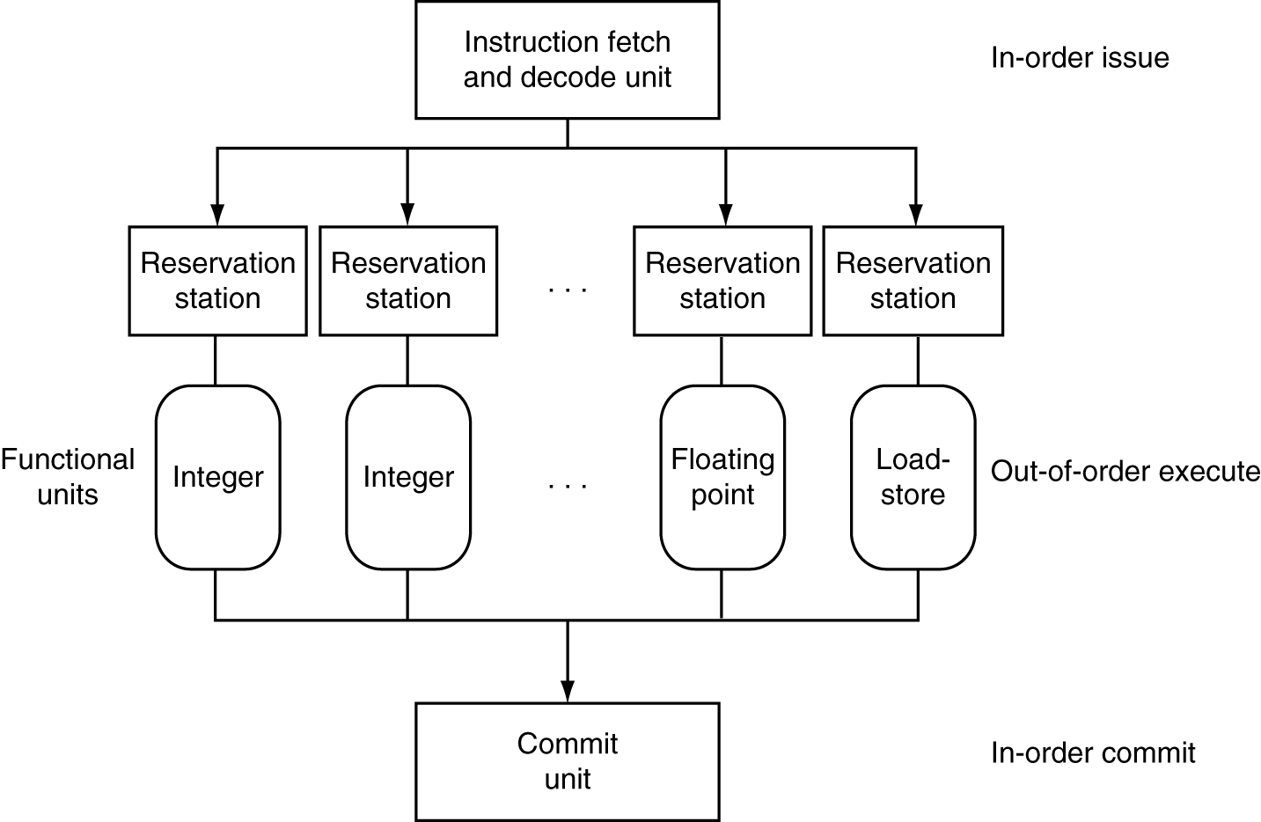
Superscalar Processor
P&H p. 340

Slide 43
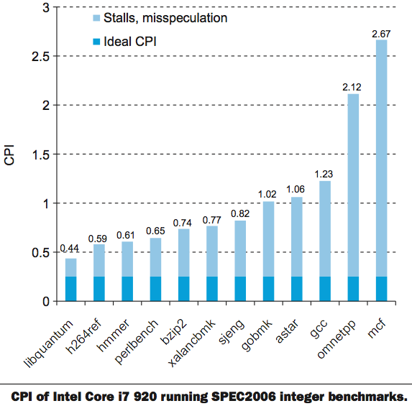
Benchmark: CPI of Intel Core i7
CPI = 1
P&H p. 350

Slide 44
In Conclusion
Pipelining increases throughput by overlapping execution of multiple instructions
All pipeline stages have same duration
Choose partition that accommodates this constraint
Hazards potentially limit performance
Maximizing performance requires programmer/compiler assistance
E.g. Load and Branch delay slots
Superscalar processors use multiple execution units for additional instruction level parallelism
Performance benefit highly code dependent

Slide 45
Extra Slides

Slide 46
Pipelining and ISA Design
RISC-V ISA designed for pipelining
All instructions are 32-bits
Easy to fetch and decode in one cycle
Versus x86: 1- to 15-byte instructions
Few and regular instruction formats
Decode and read registers in one step
Load/store addressing
Calculate address in 3rd stage, access memory in 4th stage
Alignment of memory operands
Memory access takes only one cycle

Slide 47
Superscalar Processor
Multiple issue “superscalar”
Replicate pipeline stages ⇒ multiple pipelines
Start multiple instructions per clock cycle
CPI < 1, so use Instructions Per Cycle (IPC)
E.g., 4GHz 4-way multiple-issue
16 BIPS, peak CPI = 0.25, peak IPC = 4
Dependencies reduce this in practice
“Out-of-Order” execution
Reorder instructions dynamically in hardware to reduce impact of hazards
CS152 discusses these techniques!

